Slide 1

Architecture Review
Solar System notification system

Slide 2
SS Notification System design
Identity manager
Client notification feed
Notification Manager
Web App
Delivery Layer
Email notification
Push notification
Scheduler

Slide 3
Notification System User Interface
Go
Create New
User name / Department
Logout
Created date
Sender
All
new
HR
Development
DevOps
Sales
Management

Slide 4
Notification System User Interface
Go
Back to Notifications
User name / Department
Logout
To
Subject
Message
Schedule
Send

Slide 5
Notification System User Interface
Go
Back to Notifications
User name / Department
Logout
First name
HR
Last name
Development
DevOps
Email
Sales
Department
Managament
Reset Password
Save

Slide 6
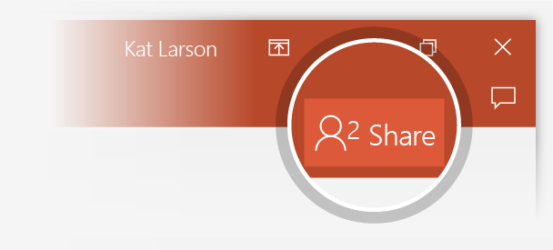
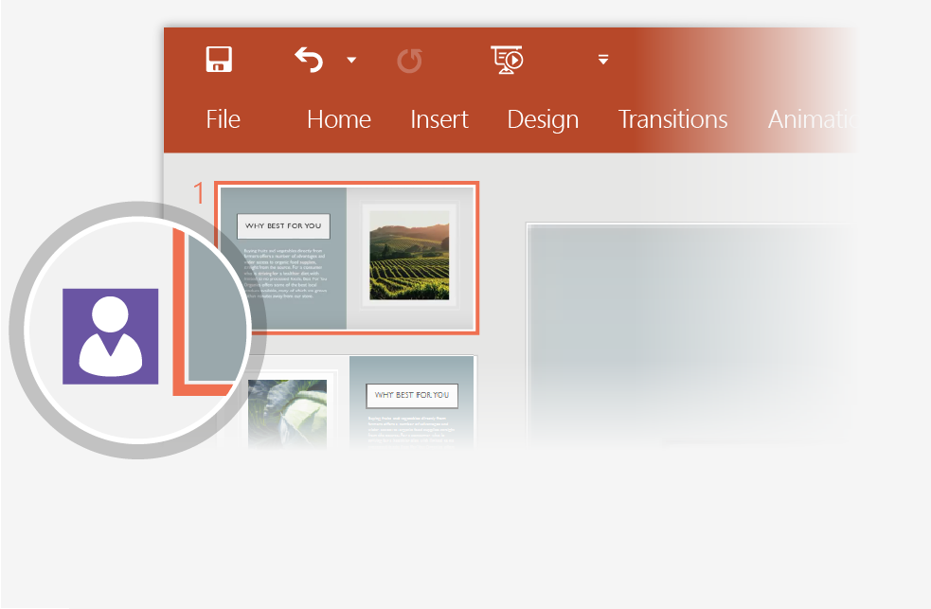
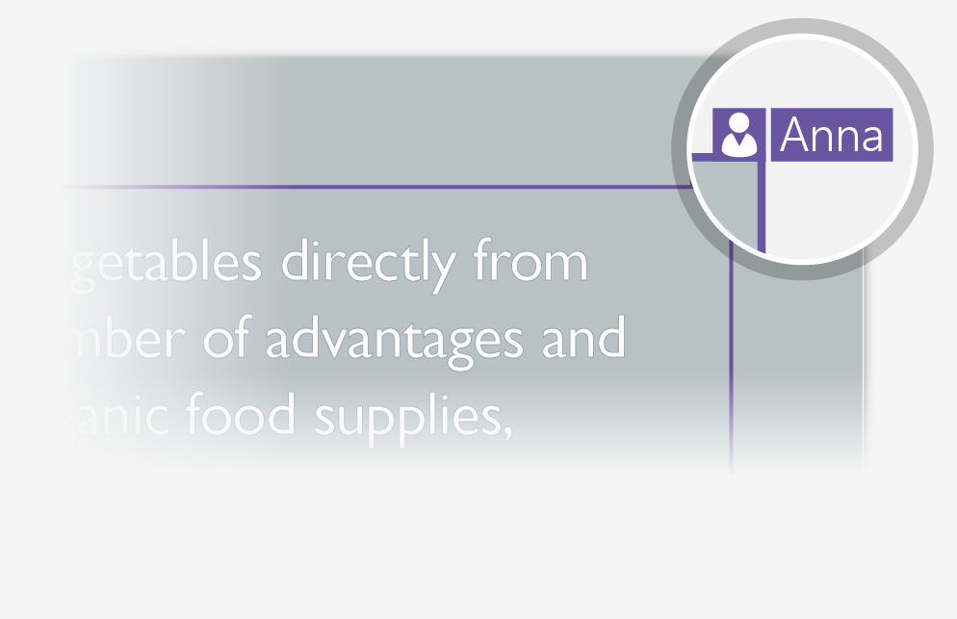
Working together in real time
When you share your presentation with others, you’ll see them working with you at the same time. How it works:
1
Select Share from above the ribbon, or by using short-key Alt-ZS, to invite people to work with you (You can save to the cloud at this point.)
2
When other people are in the presentation, a marker shows who is on which slide…
3
…and the part of the slide they're editing.

Slide 7


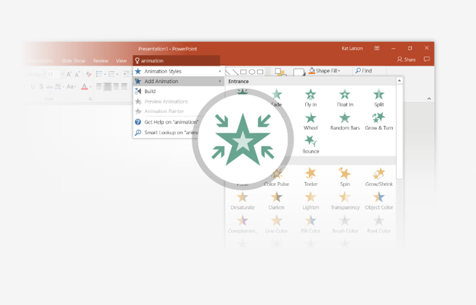
You’re an expert with Tell Me
The Tell Me box finds the right command when you need it, so you can save time and focus on your work. Try it:
SELECT ME
1
Select the Robot picture on the right.
2
Type animation in the Tell Me box, and then choose Add Animation.
3
Choose an animation effect, like Zoom, and watch what happens.

Slide 8
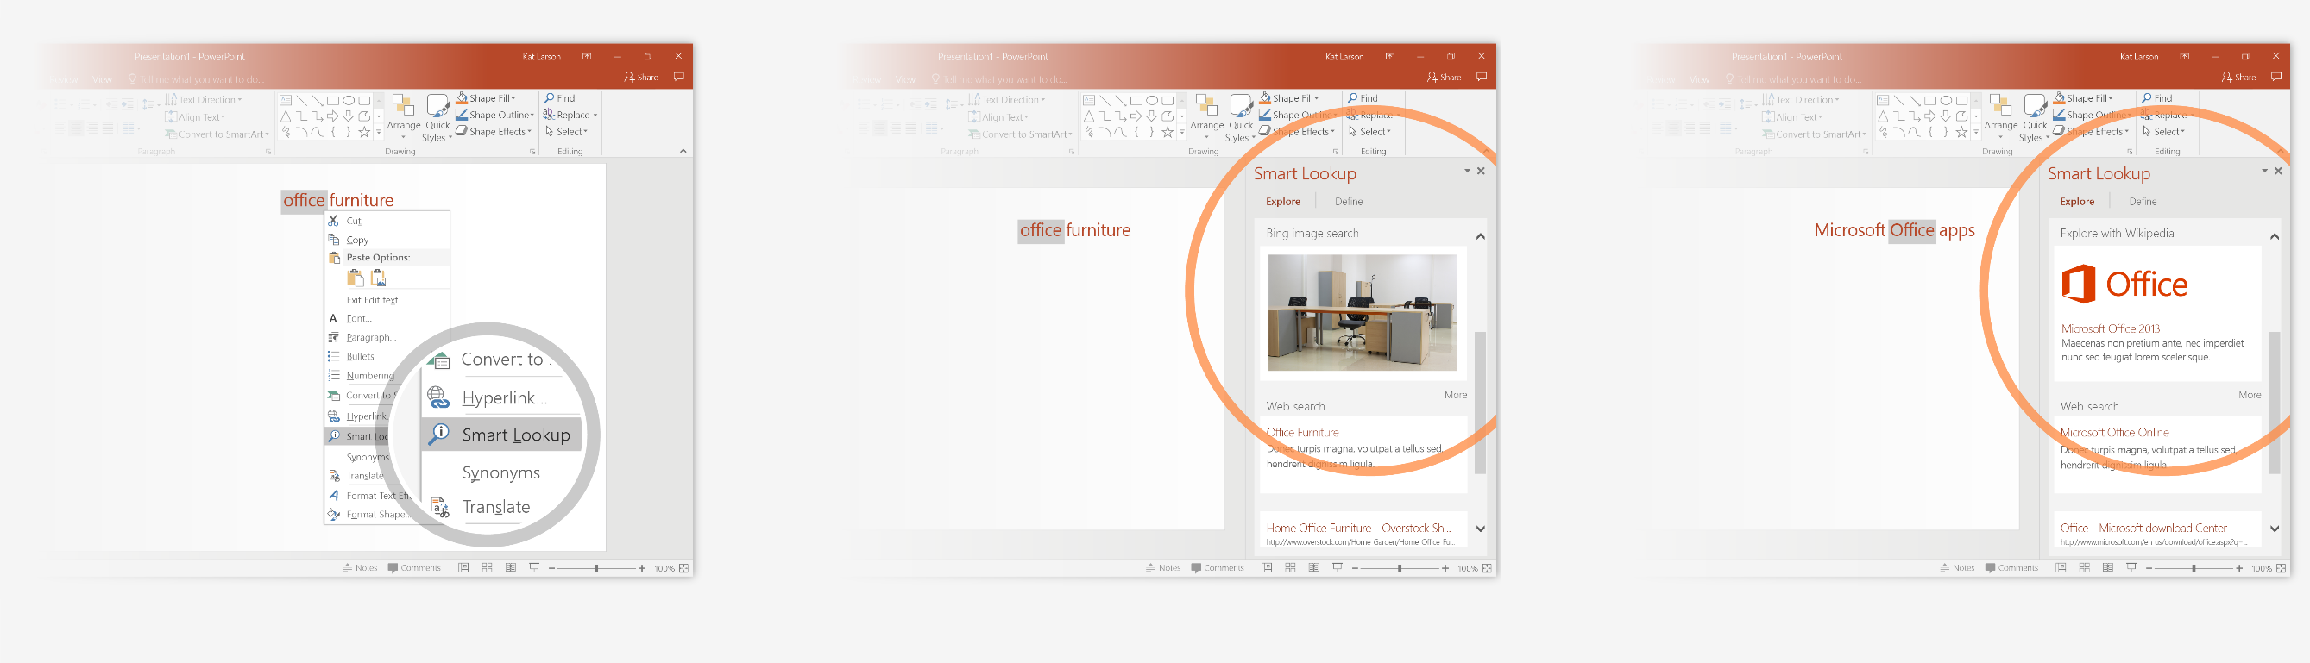
Explore without leaving your slides
Smart Lookup brings research directly in to PowerPoint. Try it:
1
Right-click in the word office in the following phrase: office furniture
2
Choose Smart Lookup, and notice that results are contextual for that phrase, not Microsoft Office apps.
3
Just for fun, try Smart Lookup again by right-clicking in the word Office in Step 2.

Slide 9

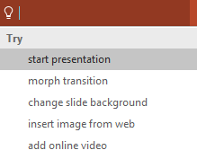

More questions about PowerPoint?
Select the Tell Me button and type what you want to know.
Visit the PowerPoint team blog
Go to free PowerPoint training
Give feedback about this tour
SELECT THE ARROW WHEN IN SLIDE SHOW MODE
Notes:
In Slide Show mode, select the arrows to visit links.

